Slide 1
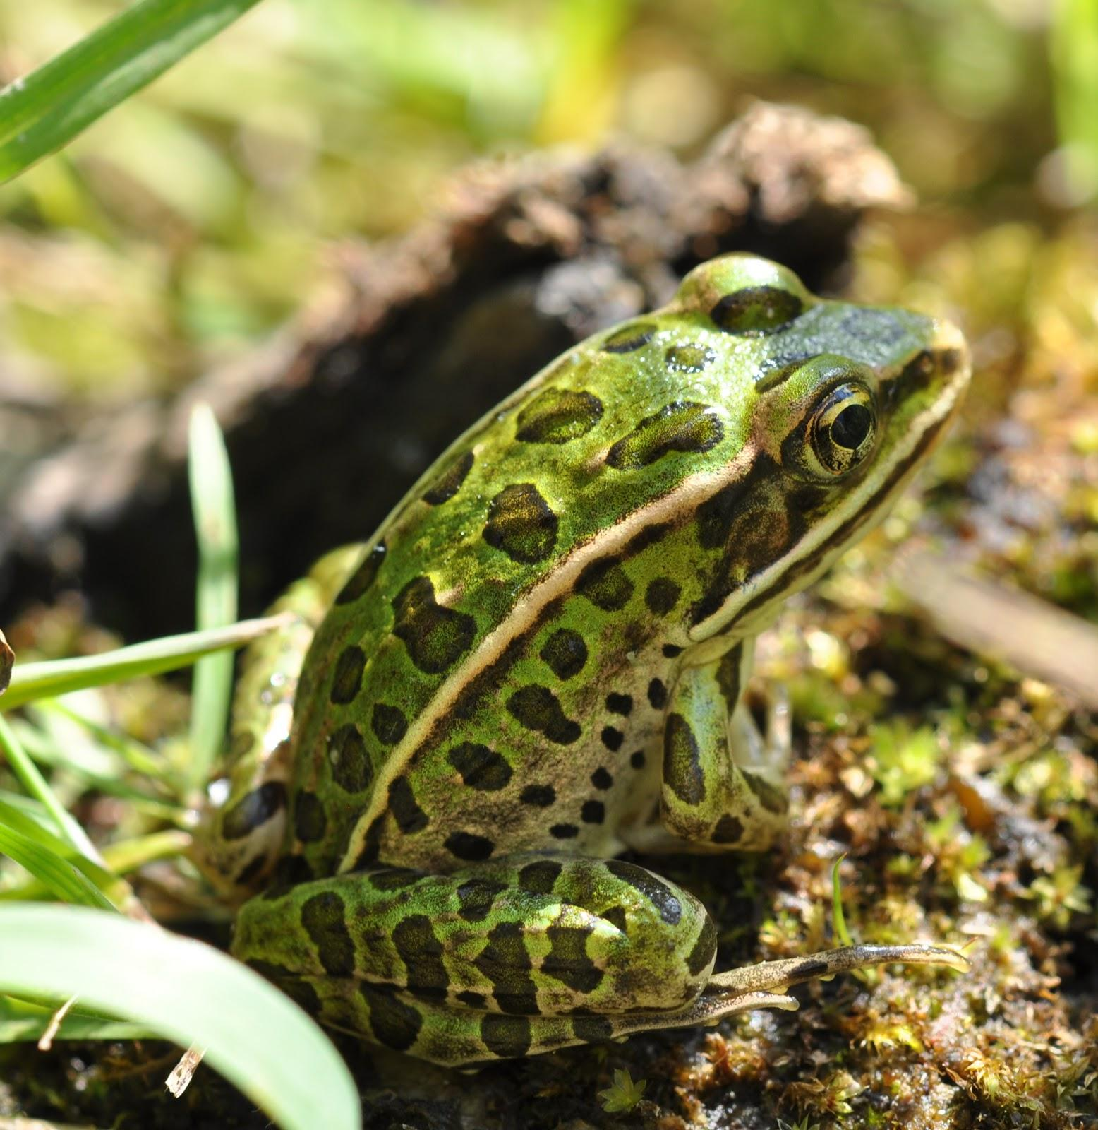
The Marshlands
Join us on an adventure as we get froggy and leap into the Louisiana Wetlands discovering more about our ecosystem.
By:
Kimberly Boudreaux
Daislynn Kimball

Slide 2
Ecosystem
a community of living organisms in conjunctions with the nonliving components of their environment, interacting as a system.

Slide 3
Living Components
Herbivores: an animal that is anatomically and physiologically adapted to eating
plant material for main component of their diet.
Carnivores: an organism that derives its’ energy by consuming mainly animal flesh; rather through predation or scavenging.

Slide 4
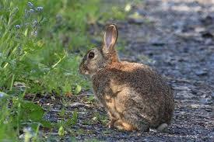
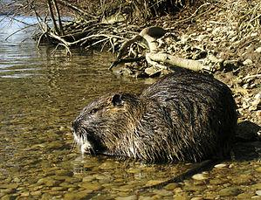
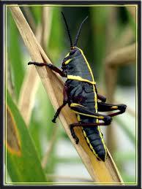
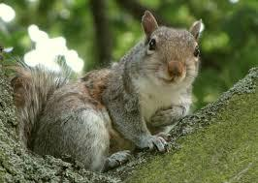
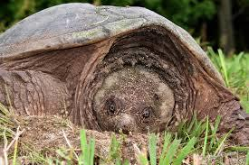
Herbivores:
Marsh Rabbit
Nutria Rat
Grasshopper
Snapping Turtle
Squirrel

Slide 5
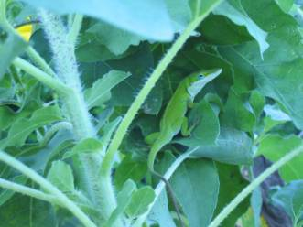
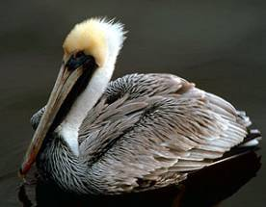
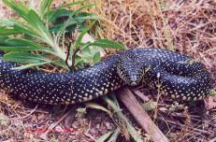
Carnivores:
Green Anole Lizard
American Alligator
Brown Pelican
Speckled King Snake

Slide 6
Non Living Components:
Non Living components of an ecosystem:
Sun
Water
Air
Soil
Minerals

Slide 7
Non-Living components
Sunlight
Air
Water
Soil

Slide 8
The crayfish eats the snail. The crayfish is a Level 2 consumer.
The water lily is a plant that thrives through photosynthesis. The water lily is considered a producer.
Finally, the snake eats the frog. He then becomes a Level 4 consumer.
The snail eats the water lily. The snail is a herbivore and a Level 1 consumer.
The bullfrog then eats the crayfish making it a Level 3 consumer.
An example...

Slide 9
Removal of Water: Harmful, or Helpful?
*The removal of water from the Marshland ecosystem, better known as wetlands would be detrimental to the Marsh. Removal of water would cease the existence of the wetlands.
*No water would cause most of the species located in the marsh to either relocate, or die out.
*Without water the ecosystem would be insufficient to sustain animal and plant life.
So is the removal of water harmful, or helpful?

Slide 10
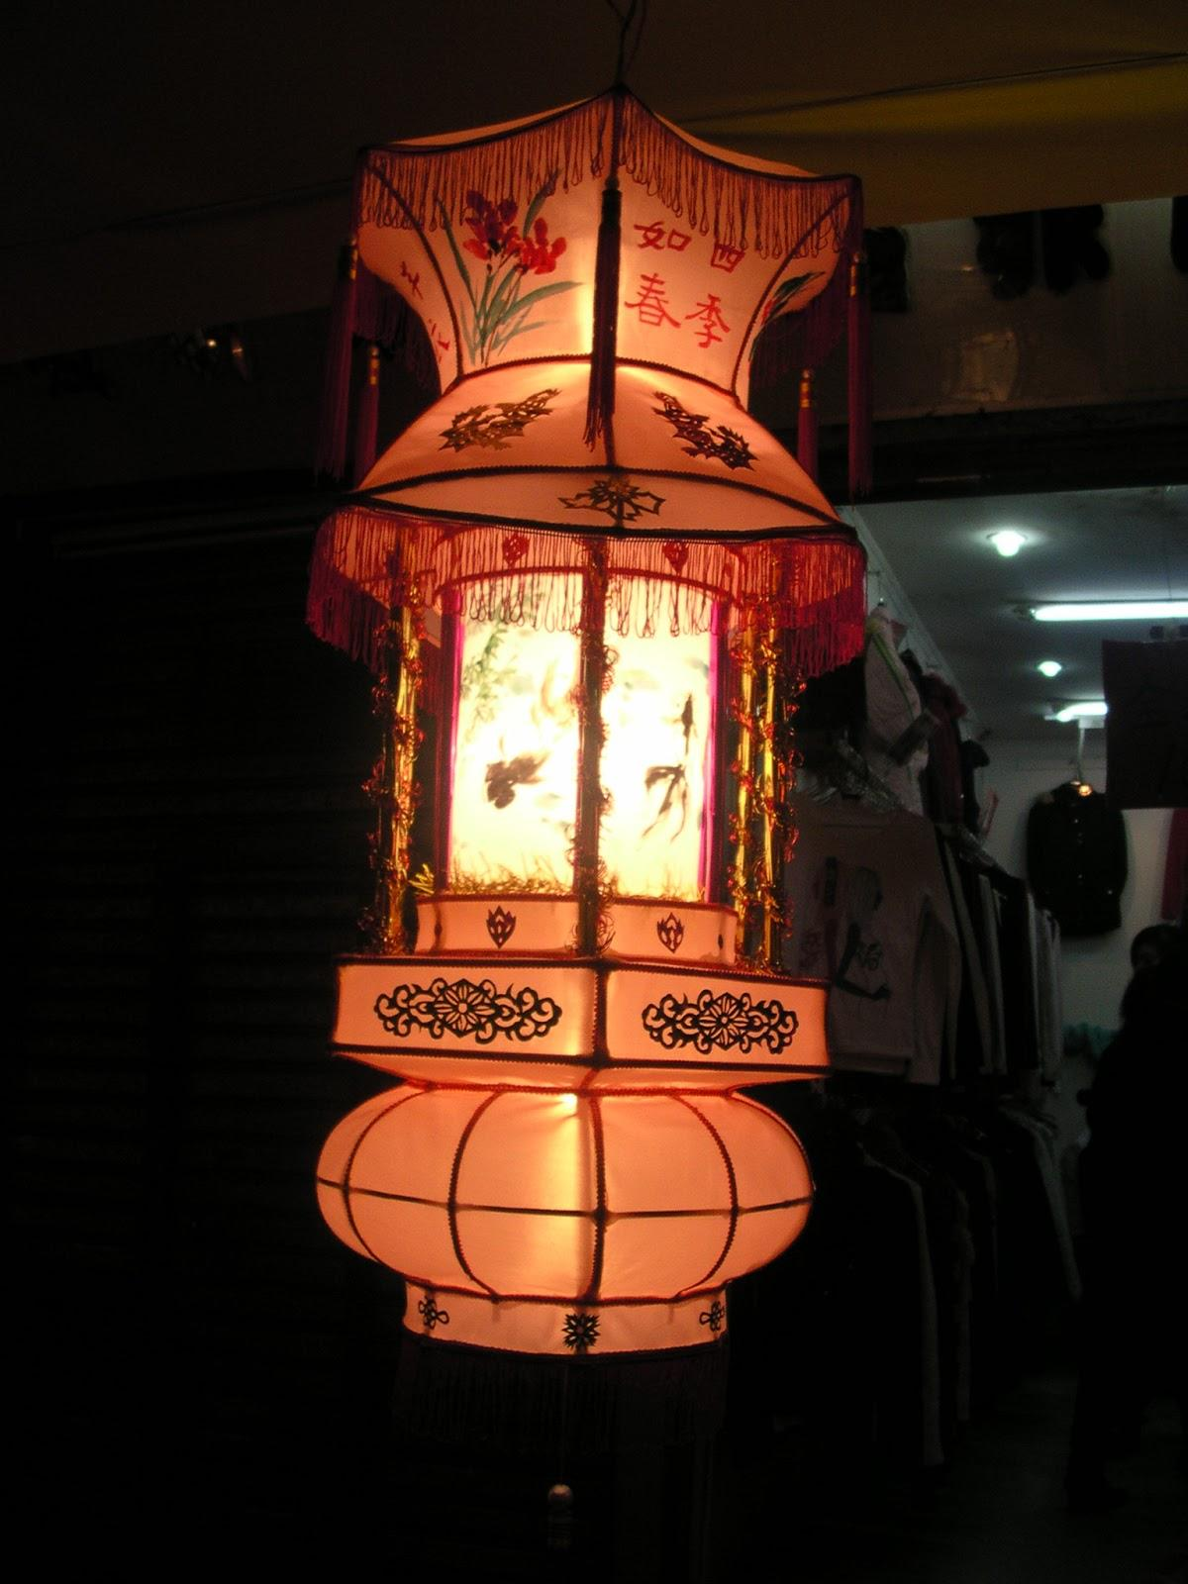
Removal of Sunlight
Harmful, or Helpful?
Most plant life in the marshland depends on photosynthesis.
Without plant life, most herbivores would perish.
Without Herbivores, most carnivores would either relocate to find food, or perish.
Algae thrives on Sunlight. Without sunlight it would not exist. Some small parasitic components, snails and herbivores have algae as a food source.
Sunlight also creates vitamin D which is an energy source for all living components.
So is the removal of sunlight harmful, or helpful?

Slide 11
Harmful or Helpful?
Removal of large overpopulated predators
Legal hunting helps to balance the ecosystem by eliminating the quantity of top predators in the region. So is the removal harmful, or helpful?

Slide 12
soil
water
Non-living Components
Hunters
Nutria Rat
Death
Herbivores
natural causes
Marsh Rabbit
carnivores
pelicans
alligators

